Slide 1
Module 5
MP Neuron

Slide 2
Introduction to neuron
The most fundamental unit of a deep neural network is called an articial neuron
Why is it called a neuron ? Where does the inspiration come from ?
The inspiration comes from biology (more specically, from the brain)
biological neurons = neural cells =neural processing units
We will first see what a biologicalneuron looks like ..

Slide 3
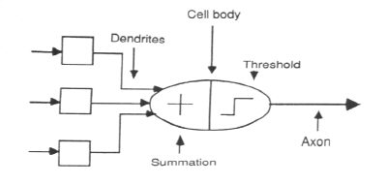
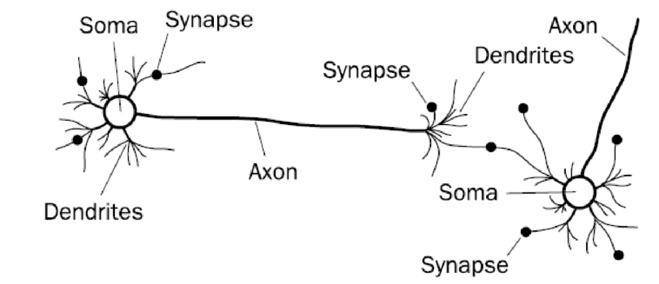
Biological Neural Network
Soma or cell body- where the cell nucleus is located.
2. Dendrites- where the nerve is connected to the cell body.
3. Axon- which carries the impulse of the neuron.
4. synapse-the end of axon split. Neuron introduce its signal to other nearby neuron.

Slide 4
Biological Neural Network
dendrite: receives signals from other neurons
synapse: point of connection to other neurons
soma: processes the information
axon: transmits the output of this neuron

Slide 5
Example continued
Of course, in reality, it is not just a single neuron which does all this There is a massively parallel interconnected network of neurons.
The sense organs relay information to the lowest layer of neurons
Some of these neurons may re (in red) in response to this information and in turn relay
information to other neurons they are connected to
These neurons may also re (again, in red) and the process continues eventually resulting in a response (laughter in this case)

Slide 6
Example
Let us see a very cartoonish illustration of how a neuron works
Our sense organs interact with the outside world
They relay information to the neurons
The neurons (may) get activated and produces
a response (laughter in this case)
Slide Adopted from
Mitesh M. Khapra CS7015 (Deep Learning) : Lecture 2

Slide 7
Example
This massively parallel network also ensures that there is division of work.
Each neuron may perform a certain role respond to a certain stimulus

Slide 8
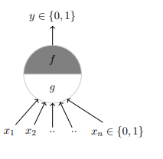
MP Neuron
McCulloch (neuroscientist) and Pitts (logician) proposed a highly simplified computational model of the neuron (1943)
g aggregates the inputs and the function f takes a decision based on this aggregation The inputs can be excitatory or inhibitory
y = 0 if any xi is inhibitory,
else g(x1, x2, ..., xn) = g(x) = ∑ xi
y = f(g(x)) = 1 if g(x) ≥ θ
= 0 if g(x) < θ
θ is called the thresholding parameter This is called Thresholding Logic

Slide 9
McCulloch-Pitts Neuron
Called M-P neuron
Activation of a M-P neuron is binary
At any time step the neuron may fire or may not fire
The weight associated with communication links may be excitatory(positive) or inhibitory(negative).
All the excitatory connected weights entering into a particular neuron will have same weight.
The threshold plays a major role in M-P neuron

Slide 10
Logic Gates Using MP Neuron

Slide 11
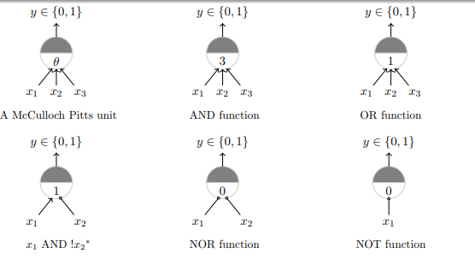

Slide 12
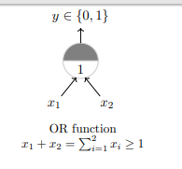
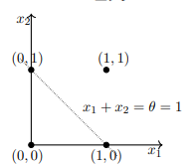
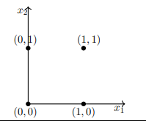

Slide 13
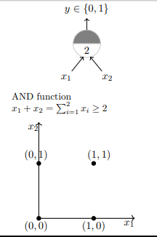
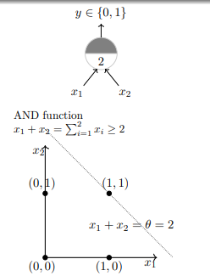

Slide 14
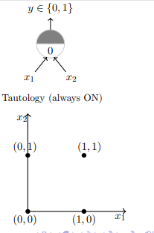
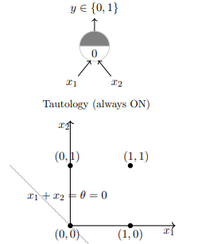

Slide 15
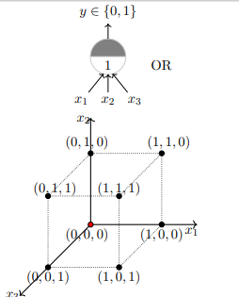
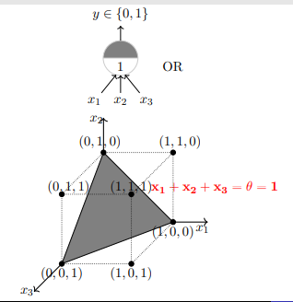
What if more than 2 input ?

Slide 16
Linear Separability
ANN provide Possible approximate solutions to non linear problems
Linear Separability :Linear separability, is a concept wherein the separation of the input space into regions is based on whether network response is Positive or negative. A decision line separate the response.
To classify the patterns based upon their output responses.
If there exist weights (with bias) for which the training input vectors having positive (correct) response,+ 1, lie on one side of the decision boundary and all the other vectors having negative (incorrect) response, -1, lie on other side of the decision boundary. then we can conclude the/Problem "linearly separable.“
yin=b+x1w2 +X2w2
The separating line for which the boundary lies between the values X1 and X2· so that the net gives a positive response on one side and negative response on other side, is given as
b+x1w1 +X2w2 > 0 for positive response.

Slide 17
Introduction to perceptron Network
What about non-boolean (say, real) inputs ?
Do we always need to hand code the threshold ?
Are all inputs equal ?
What if we want to assign more weight (importance) to some inputs ?
What about functions which are not linearly separable ?

Slide 18
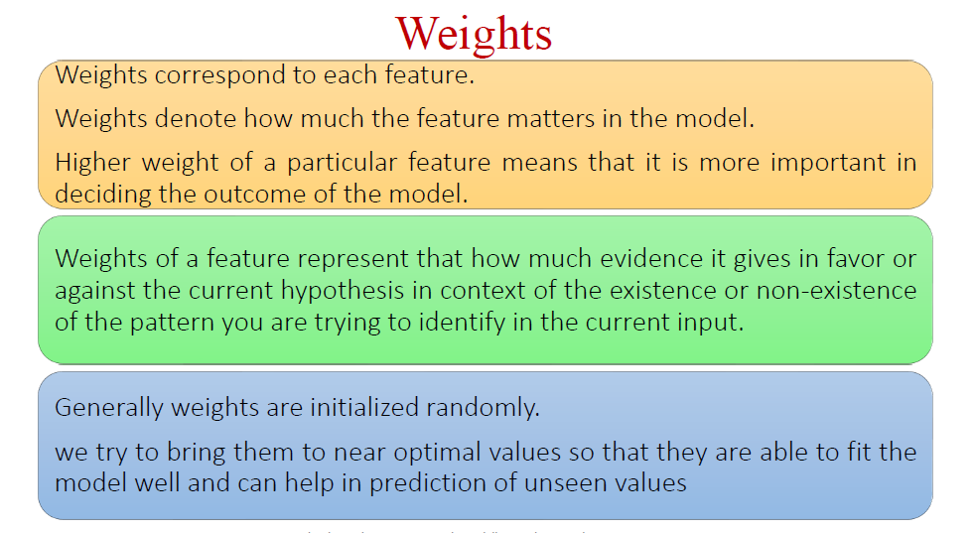
Introduction to weights ?

Slide 19
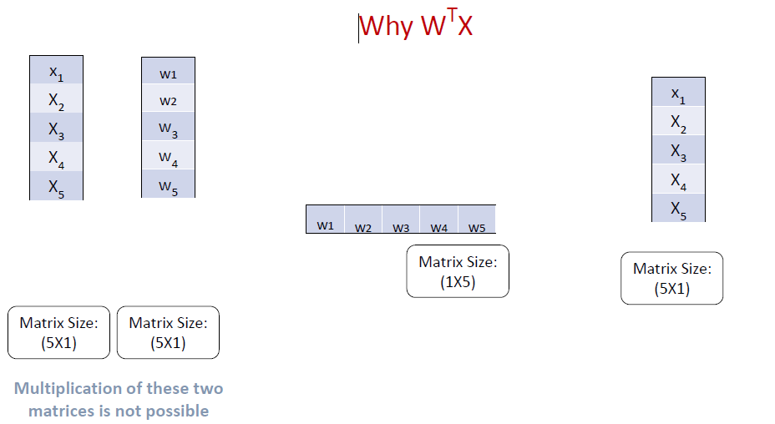

Slide 20
Perceptron Network
Frank Rosenblatt, an American psychologist, proposed the classical perceptron model (1958)
A more general computational model than McCulloch–Pitts neurons
Main differences: Introduction of numerical weights for inputs and a mechanism for learning these weights
Inputs are no longer limited to boolean values

Slide 21
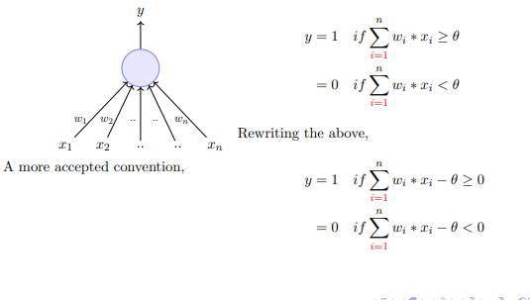


Slide 22
